Slide 1
Design and implementation of a MLP (MNIST)
Franck225-coder

Slide 2
Outline
Machine Learning (ML) basics
ML Vs. Deep Learning (DL)
Neural Network Intro
NN Implementation (MNIST dataset)
Main components/hyper-parameters:
optimizers, cost functions and training
regularization methods
Result and discussion

Slide 3
Machine Learning (ML) Basics
Machine learning is a field of computer science that gives computers the ability to learn without being explicitly programmed
Labeled Data
Machine Learning algorithm
Training
Prediction
Labeled Data
Learned model
Prediction

Slide 4

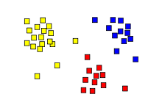
Types of Learning
Supervised: Learning with a labeled training set
Example: email classification with already labeled emails
Unsupervised: Discover patterns in unlabeled data
Example: cluster similar documents based on text
Reinforcement learning: learn to act based on feedback/reward
Example: learn to play Go, reward: win or lose
class A
class A
Classification
Regression
Clustering

Slide 5
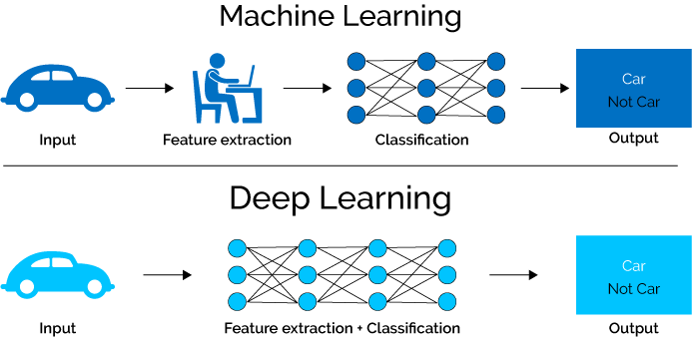
ML vs. Deep Learning (DL)
A machine representations of data. Exceptional effective at learning patterns. learning subfield of learning
Deep learning algorithms attempt to learn (multiple levels of) representation by using a hierarchy of multiple layers
If you provide the system tons of information, it begins to understand it and respond in useful ways.

Slide 6
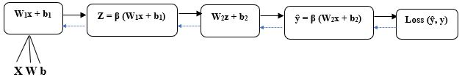
Neural Network Intro
• (X) denoting the input layer
• (y) represents the actual output layer
• (Z) holds the result of the activation function applied to the inputs
• (ŷ) is the predicted output layer
• (W) representing the Weights including w1, w2
• (b) is the Bias present at each layer including b1, b2
• (β) an activation function
• One or more hidden layers
• Feedforward
• Backpropagation

Slide 7
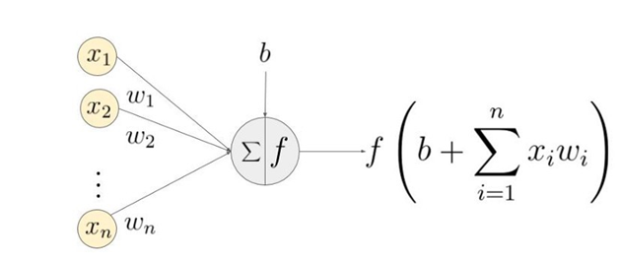
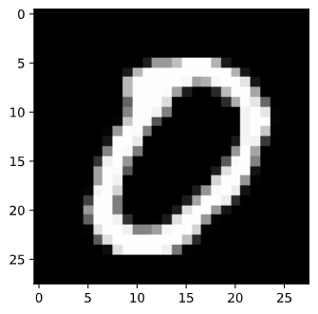
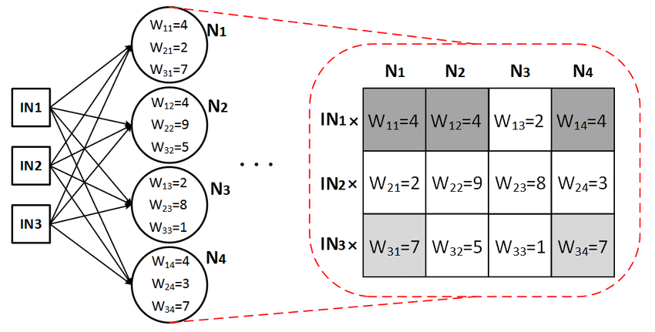
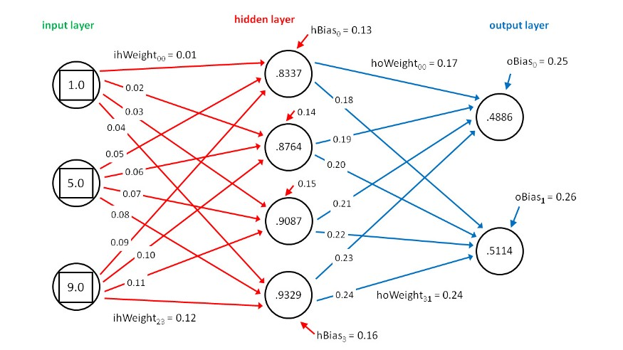
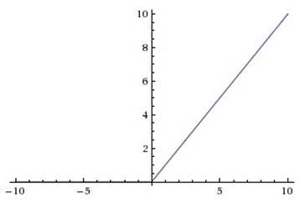
Basic NN building Blocks
Inputs / outputs
2. Weights
3. bias
4. Activation function
(ReLu)
f(z) = max(0,z)
Activation functions serve two primary purposes:
Help a model account for interaction effects: It is when one variable A affects a prediction differently depending on the value of B.
Help a model account for non-linear effects: This just means that if I graph a variable on the horizontal axis and my predictions on the vertical axis, it isn't a straight line.
Notes:
Activation functions serve two primary purposes:
Help a model account for interaction effects: It is when one variable A affects a prediction differently depending on the value of B.
Help a model account for non-linear effects: This just means that if I graph a variable on the horizontal axis and my predictions on the vertical axis, it isn't a straight line.

Slide 8
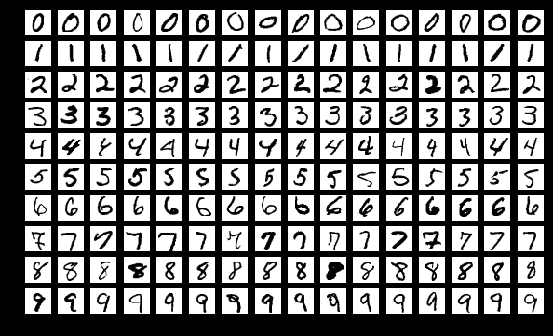
Implementation and Training
Data collection
NN architecture
Training and Validation
The MNIST of handwritten digits contains 60,000 training images and 10,000 test images each of size 28 x 28 pixels, including numbers 0- 9 total 10 categories.

Slide 9
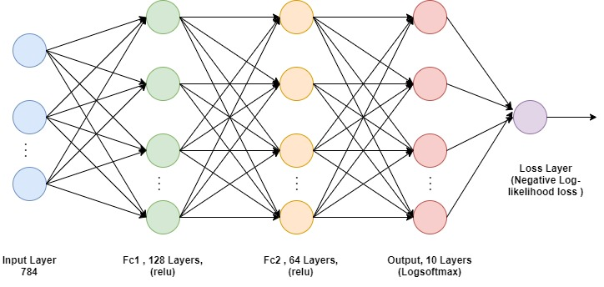
Implementation and Training
NN architecture
Training process
Sample labeled data
(batch)
Forward it through the network, get predictions
Back-propagate the errors
Update the network weights

Slide 10
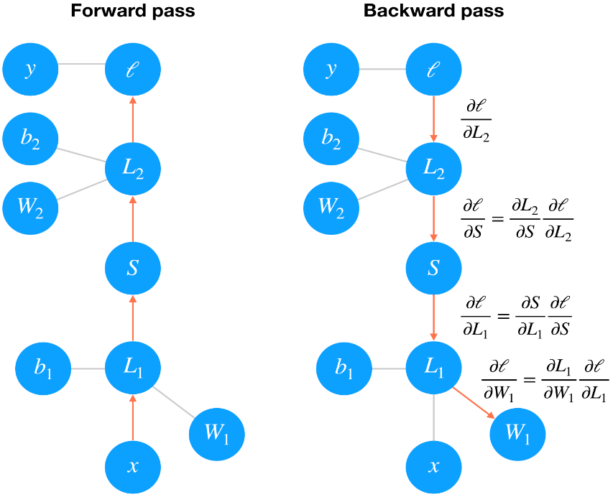
Gradient Descent
Mathematically, this is just calculating the gradient of the loss with respect to the weights using the chain rule.
We update our weights using this gradient with some learning rate
The learning rate is set such that the weight update steps are small enough that the iterative method settles at a minimum
Notes:
By minimizing the loss with respect to the network parameters,
we can find configurations where the loss is at a minimum and
the network can predict the correct labels with high accuracy.
We find this minimum using the Gradient Descent process.

Slide 11
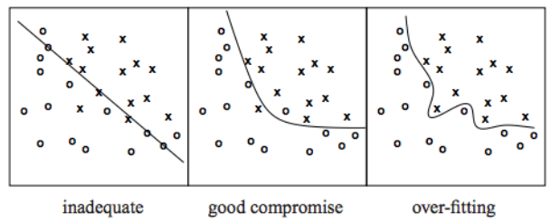
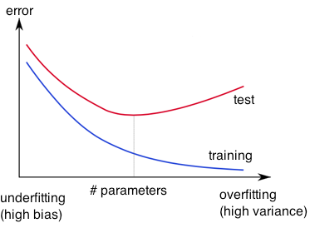
Avoid Overfitting
Learned hypothesis (model) may fit the training data very well, even outliers (noise) but fail to generalize to new examples (test data)

Slide 12
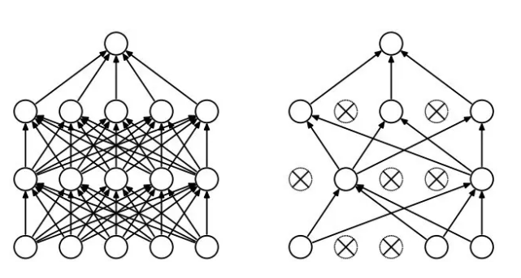
Regularization
Dropout
Randomly drop units (along with their connections) during training
Each unit retained with a fixed probability p, independent of other units
Hyper-parameter p to be chosen (tuned)
Early-stopping
Use validation error to decide when to stop training
Stop when monitored quantity has not improved after n subsequent epochs
n is called patience
Notes:
L2 = weight decay
To keep the weights small and avoid exploding gradient.
Because the L2 norm of the weights are added to the loss,
each iteration of your network will try to optimize/minimize
the model weights in addition to the loss. This will help keep
the weights as small as possible, preventing the weights to grow
out of control, and thus avoid exploding gradient

Slide 13
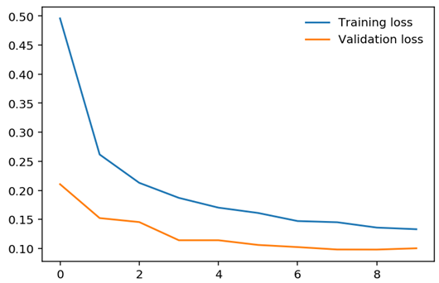
Training parameters and validation
By performing gradient descent and updating the weights by back-propagation, the model gets better at performing the classification. Therefore, in each epoch, we will be observing a gradual decrease in training loss. The table below is a summary of the training parameters.
Training Parameters
Batch_size | 64
Learning rate | Lr = 0.001
Epoch | 10
Optimizer | Adam
Shuffle | True
Activation function | Relu() and LogSoftmax()
Dropout | True (P=0.2)
Framework | PyTorch

Slide 14
Result and evaluation
The accuracy is calculated based on the top-class predictions made by our network compared to the actual labels. The network got an accuracy of 96.97% (Shown in the code).

Slide 15
Conclusion
The MNIST dataset is quite simple, therefore the model could easily pick up patterns within the data and correctly classify the digits. Therefore, we implemented quite similar architecture (with more layers) to test our new model on the Fashion MNIST dataset which shows a more complex structure than MNIST handwritten dataset and we had an accuracy of 86,67%.

